Slide 1
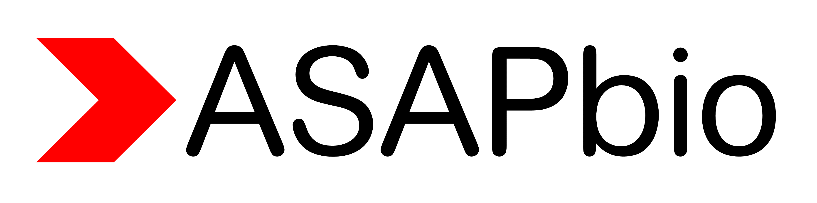
Author attitudes toward preprint licensing
This survey was conducted as part of ASAPbio’s preprint licensing group (asapbio.org/licensing). Out of 169 total responses, 117 were from authors who had posted a preprint and chosen the license. Charts shown here reflect the properties of this smaller group. More information and original data at http://asapbio.org/licensing-survey
Demographics
Note: Non-exclusive, and not inclusive of all write-in responses

Slide 2
Licensing choice
Selected quotes in response to prompt “If factors not listed above were important to you, please explain below.“
To be honest, I was very confused by the difference between some of the choices. I haven’t looked recently, but it seems like the explanations and consequences of the different options should be explained better.
(License choice: CC BY-ND)
I was surprised by the question. Had no relevant existing knowledge nd tried to find the option tht would not interfere with future publiction while aiding "open science". I didn't know nor currently remember the meaning of the codes listed above.
(License choice: Don’t know)
I really did not understand the options and thus guessed as to which would be less likely to cause trouble when the paper was accepted at a journal
License choice: Don’t know)
I want my work to be useful (liberally licensed), but I want it clear that I should be cited when my work is useful.
(License choice: CC BY)
Note: CC BY is overrepresented in this sample; see bioRxiv choices as of November 2016 below from Daniel Himmelstein http://blog.dhimmel.com/biorxiv-licenses/
License | Count | Percent
CC BY | 1,237 | 17.8%
CC BY-ND | 496 | 7.2%
CC BY-NC | 586 | 8.5%
CC BY-NC-ND | 2,553 | 36.8%
None | 2,061 | 29.7%

Slide 3
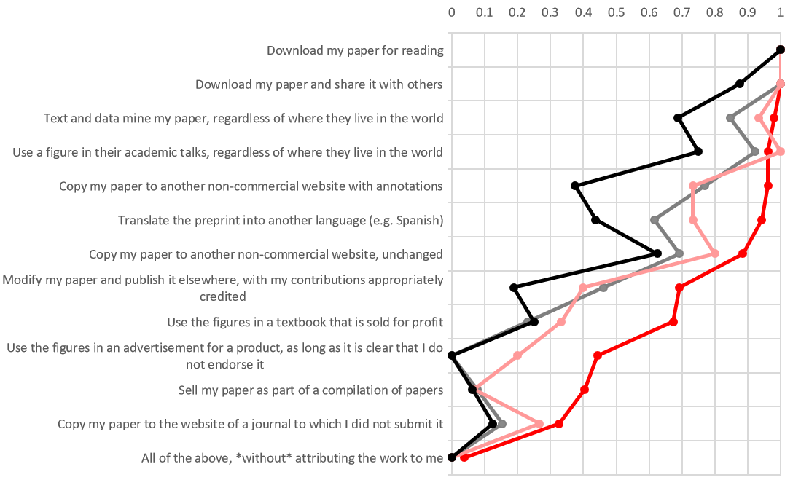

Attitudes toward reuse by license choice
What would you like others to be able to do with your preprint, without having to ask for your permission? Assume, unless noted, that your work would be attributed to you and your co-authors.
Fraction of affirmative responses

Slide 4
Other comments
Selected responses to prompt “Do you have any other comments regarding preprint licensing?”
Lack of understanding
Tradeoffs
Policies
Credit (financial and professional)
I think most people, like me, don't completely understand the differences between different licenses, or how a preprint license impacts the journal license.
Some of the list above are things that I don’t actively ‘want’ (eg selling it in a collection) but I’m not that bothered if people choose to and would rather have unrestricted reuse rather than putting restrictions on it that are unlikely to ever be challenged by anyone anyway.
People are dumb and make wrong choices with good intentions, but misinformed all the while. Accept that and guide them towards the best choices whilst allowing them to choose something different if they can reasonably justify it.
I would want credit for anything commercial arising. Potentially financial credit.
Professional attribution standards still apply.
I do not _like_ some of the commercial options, but am willing to accept them giving how problematic NC can turn out to be in practice
The world would be far better place if CC BY is mandatory for every scholarly work.
I know that this is important and I promise I have tried to understand licencing, but I simply don't understand it and there is conflicting advice on what to do.

